Slide 1

Stock Portfolio Analysis DSS
DESC 385 Project
Hao Yin

Slide 2
Introduction
Objective
Data, Input, Output, Interface
Basic of the model
Knowledge base
Demo of the prototype
Test result
Conclusion

Slide 3
Objective
Two key decisions of building stock portfolio
  what to buy
  how many to buy
Many investors decide them by intuition
The DSS can provide better solution from knowledge base (Modern Portfolio Theory + Genetic Programming technology)

Slide 4
Data, Input, Output, Interface
Data: Static financial quotes from Yahoo! Finance ->real-time quotes
Input: Prices of pre-selected stocks -> selected by user
Output: Suggestion on the weights -> Report
Interface: Excel -> Web

Slide 5
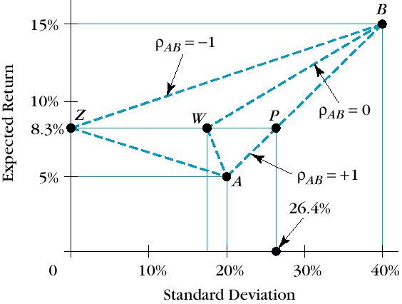
Basic of the Model
Diversify the risk
  Random investment
  Cross-industry investment
  Modern Portfolio Theory
    Correlation between stocks

Slide 6
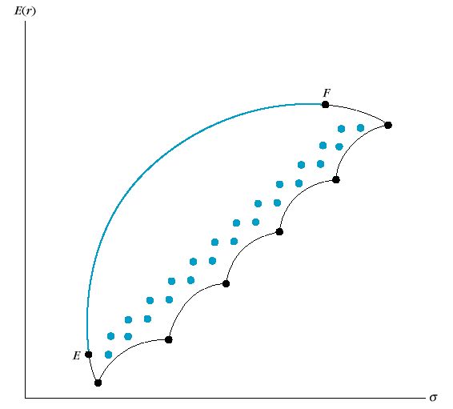
Basic of the Model 2
Efficient Frontier
Find the best solution in the past

Slide 7
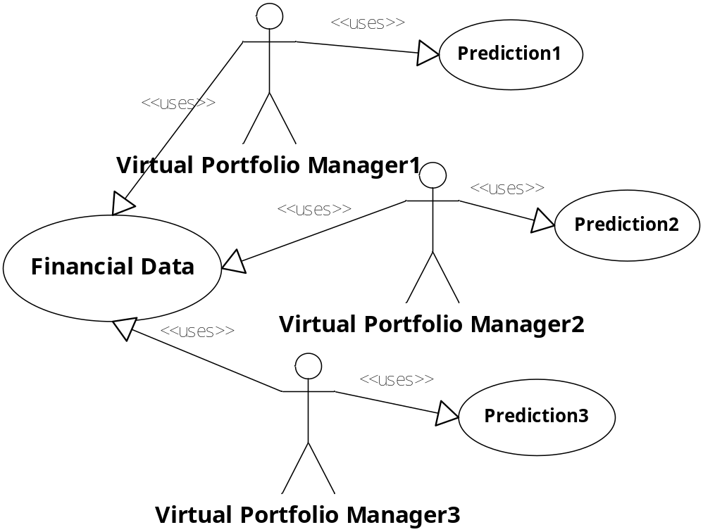
Knowledge Base
Using Genetic Programming to predict the future
Learn, evaluate, select and keep going

Slide 8
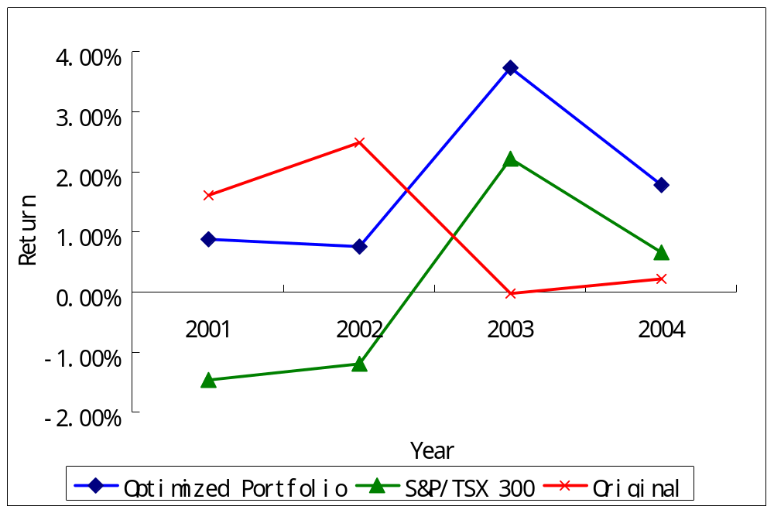
Test Result
Return/Month | Index Fund Portfolio | S&P/TSX 300 | Optimized Portfolio
2001 | 1.62% | -1.47% | 0.88%
2002 | 2.49% | -1.19% | 0.76%
2003 | -0.01% | 2.22% | 3.74%
2004 | 0.21% | 0.67% | 1.78%
Total | 4.30% | 0.24% | 7.15%

Slide 9
Conclusion
By using knowledge based DSS, we can build a better portfolio
A lot of further work to do…

